Slide 1


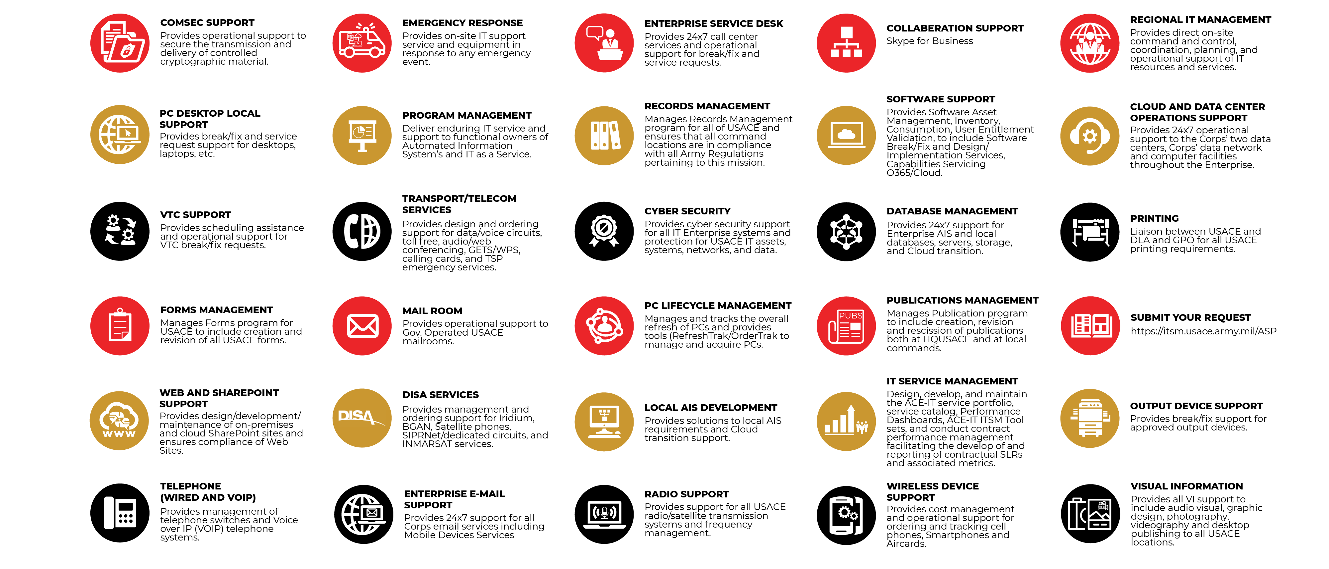
CIO/G-6 PROVIDED SERVICES (ENTOPER)

